Slide 1
Language translator using smart spectacles
-By P.Prabhakar rao
And
Team

Slide 2
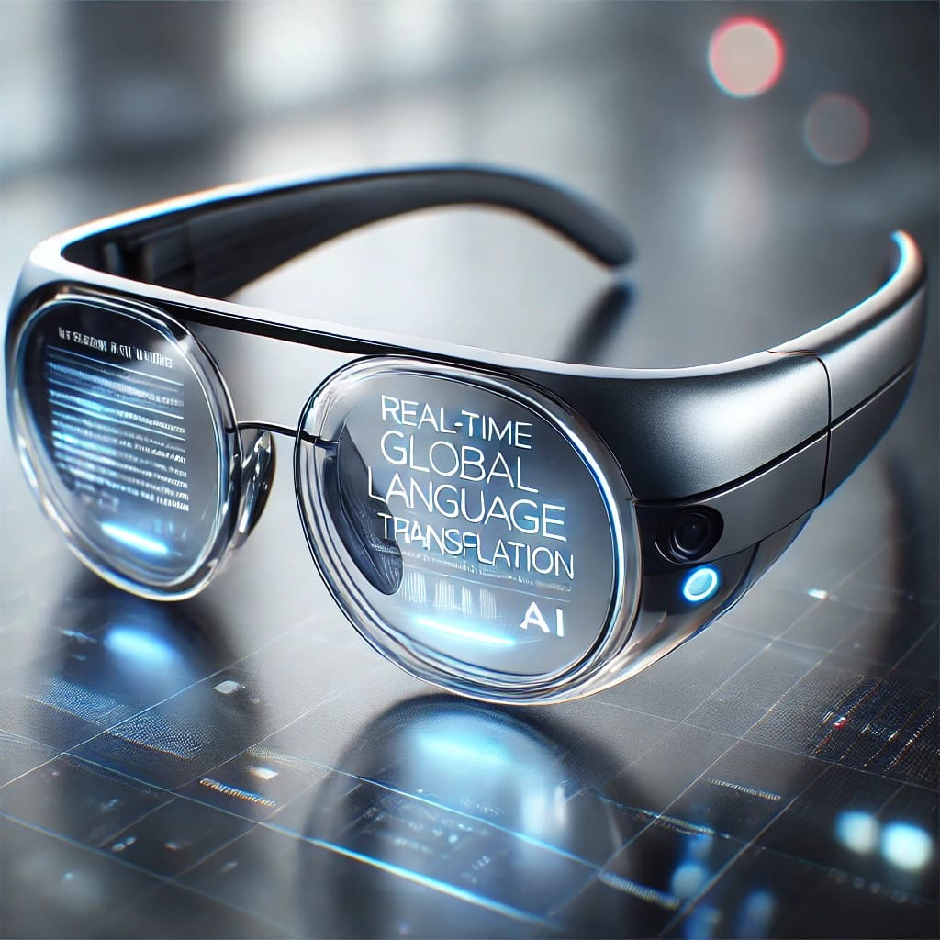

Slide 3
Intoduction:
What is the project about?
Smart spectacles integrated with a language translation system.
Converts spoken or written text into the user's preferred language in real-time.
Why is it needed?
Helps travelers, students, and professionals overcome language barriers.
Enhances communication in multilingual environments.

Slide 4
Problem statement:
People face challenges in understanding different languages.
Existing translation apps require manual input or screen interaction.
Need for a hands-free, real-time, and efficient translation system.

Slide 5
Objective:
Develop smart spectacles capable of:Recognizing and translating spoken/written text.
Displaying translated text on the lens.
Supporting multiple languages for diverse user

Slide 6
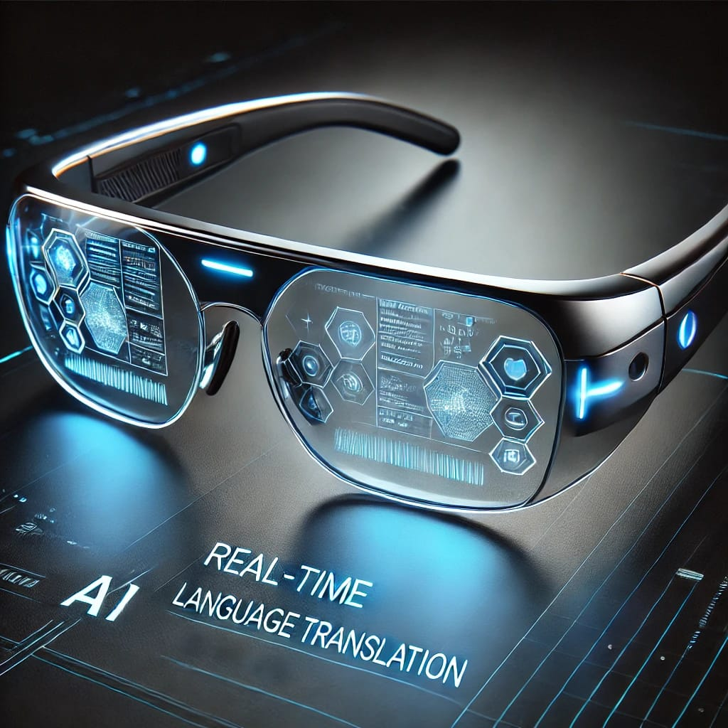

Slide 7
How it works: Architecture
Input Stage:
Microphone captures speech / Camera captures text.
Processing Stage:
AI-based NLP (Natural Language Processing) translates the input.
Output Stage:
Translation is displayed on the lens or converted into speech.

Slide 8
Technologies used:
Hardware:
Smart Spectacles with AR Display
Microphone & Camera
Software & AI:
Machine Learning & NLP (Google Translate API, OpenAI, etc.)
Optical Character Recognition (OCR) for text detection
Embedded Systems & IoT Integration

Slide 9
Features :
✅ Real-time Speech & Text Translation ✅ Augmented Reality Display for Translations ✅ Multi-language Support ✅ Offline Mode for Travel Convenience ✅ Location Tracking & Navigation Assistance ✅ User-Friendly & Hands-Free Operation

Slide 10
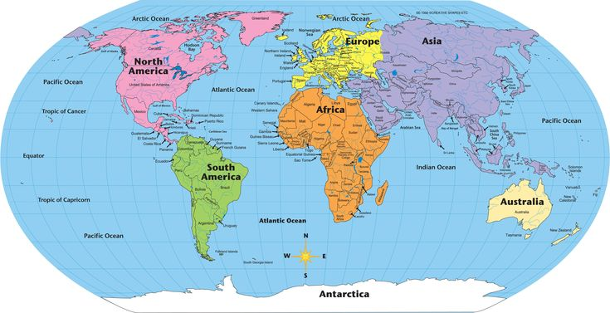

Slide 11
Applications :
📌 Tourism & Travel – Helps tourists understand signs & communicate + Shows real-time location for better navigation. 📌 Emergency Services – Helps users share their location easily in case of language barriers. 📌 Smart Navigation – Translates signs and provides directional guidance for better travel assistance.

Slide 12
Conclusion:
Smart Spectacle Translator bridges communication gaps using AI & AR.
A step towards seamless multilingual communication in daily life.
Future potential: More languages, better accuracy, and enhanced user experience.

Slide 13

Thank you
Any questions?

